Slide 1
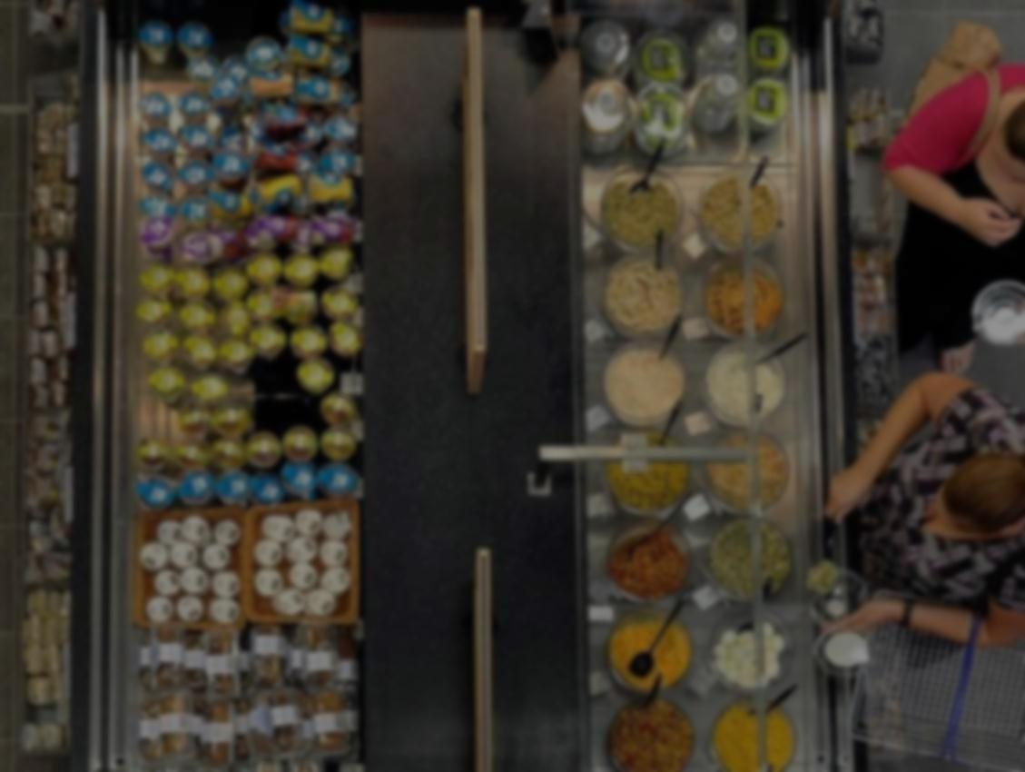
Using Agile to Manage Data Science Teams
Gabriel Straub, Tesco

Slide 2
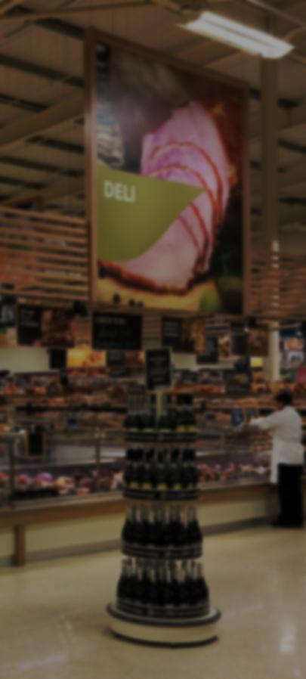
Our Definition of Data Science
Data
Insights
Options
Recomm-endation
Change
Business Insights
Data Analytics
Data Science
What is data science?
Addresses: What were my cool box sales last week?
Addresses: Were my cool box sales so high because of unexpected weather?
Addresses: Given the weather forecast you should order 200 more cool boxes.
Key Point:
Data science is about building predictive data products

Slide 3




~10
Data
Scientists
X£
~6
Parallel
Projects
What is the challenge?
Multiple
Product
Owners
Key Question:
How to organise the team to get the biggest impact while keeping everyone motivated?
Notes:
Team of 10 data scientists (and vacancies)
Multiple projects for multiple business customers at the same time
Run around 6 projects in parallel that are at different stages of development
Projects span anything from developing search engines to balancing customer fulfilment centres
Priorities often unclear and changing
We have been around for about 3 years
Tesco is not a tech company at heart, so not everyone is familiar with digital product development

Slide 4

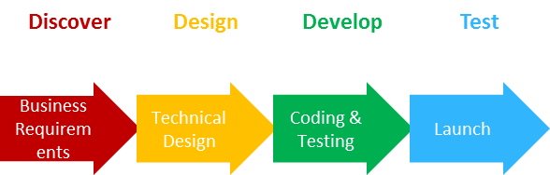
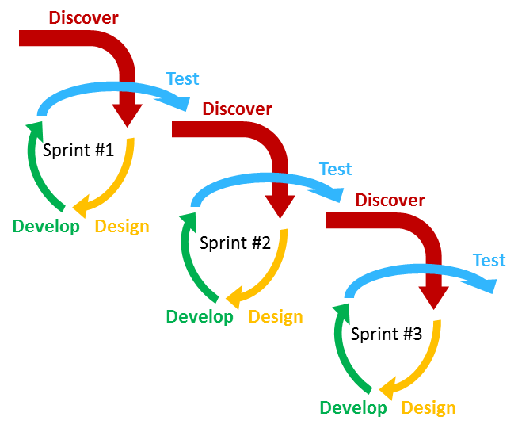
Waterfall
What is agile?
Agile
Key Point:
Collaborate with your customers to iteratively deliver something of value
Notes:
Make software development more light weight and iterative than traditional waterfall approach
Agile manifesto (2001):
Individuals and interactions over processes and tools
Working software over comprehensive documentation
Customer collaboration over contract negotiation
Responding to change over following a plan
There are multiple flavours of agile (scrum, kaban, etc.)

Slide 5

Scrum
Sprint 1
Sprint 2
Sprint 3
What different types of agile are there?
Predefined Work for Set Time
Kanban
To Do
Doing
Done
Minimise Work in Progress
Key Point:
The different types of agile differ in the process, not in the philosophy

Slide 6






Tools
Prototype
Operations
Is agile data science just about agile tools?
…
…
Organisation
?
?
?
?
?
Key Point:
As customers and projects change, you need to change the way you run your data science team
Notes:
Most articles about agile data science focus on building an agile data flow and using agile software tools that can easily scale according to the data size and complexity of the problem
In our team we generally use Python/Spark for prototyping and then a mix of Spark / Java / C# (depending on the problem) for operationalising the prototype
But agile data science is about more than tools. It is also about how to organise and run a team in order to be able to react to changing business needs or new insights

Slide 7






(Simplified) Agile Assumptions
Clear(ish) Direction
Clear(ish) Dev. Time Required
Why is agile data science so hard?
One Skillset
Data Science Reality
?
Many Specialists
Many Directions
Unclear if Possible
Key Point:
Agile for data science is hard and these methods work better for some projects and need more work for others
Notes:
Some of the key aspects of agile are:
Everyone in the team can more or less do any task
There is a fairly clear path on how to solve a problem
Before doing any work you are able to estimate how long something takes (and often what impact it will have)
Unfortunately most of these assumptions are not quite true for most data science projects:
Data scientists are often T-shaped with different deep expertise
Most problems require experimentation to find a solution

Slide 8





Key Agile Points Relevant for Data Science
How can these challenges be overcome ?
Quick Customer Feedback
Minimise Code Waste (Kill Early)
£
Customer Output over Dev. Input
Value from Customer Only
Key Point:
The key premise of agile (iterative minimal development in collaboration with customers) is valid for data science
Notes:
Still there are some key points of the agile philosophy that are really relevant for data science:
Quickly putting products in front of customers to get feedback
Quickly killing ideas that do not work (minimise throw away work)
Focus on solving customer needs rather than focus on development inputs
Value only gets achieved if customers interact with your product

Slide 9

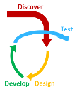
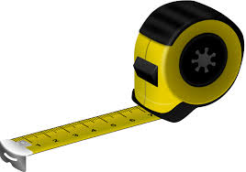
What Works
Agile about Agile
Close to Customer
Where are we now?
Still in Progress
Measuring Progress
Flexible Skills
Key Point:
The clearer you can define your overall success metric as team, the better you can adapt agile to increase your impact
Notes:
We have been running our own version of agile for almost two years
We are pretty agile about our version of agile as well. We will regularly change something about our ways of working – to the extend that we sometimes completely remove individual projects out of the process
One of our remaining big challenges is the best measure for our productivity / impact. At the moment we mostly focus on delivered points per capacity (how much work we managed to get done)
We are trying to move to a metric that is more progress focussed (along the lines of validated learnings from the lean methodology)

Slide 10

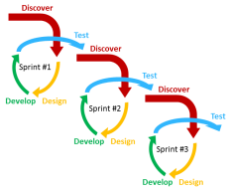

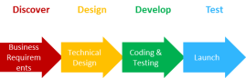




It Doesn’t Quite Work “Out of the Box”
>
So, can you use agile for data science?
Better than Alternatives
It’s a Journey
Every Team is Different
Be Honest with Yourself
Key Point:
Agile is not about the process, it’s about the philosophy of constantly wanting to be better and iterating in order to get there
Notes:
Not quite in its “out of the box” form
But it is much better than anything we have tried before
It’s a journey and we are still far away from the destination
You have to be honest with yourself: every two weeks we discuss what is and what isn’t working and then prioritise one thing that we will change for the next sprint
I don’t think there is one right way of managing a data science team (and all teams are differently anyway), but I think that one can always iterate towards finding better ways

Slide 11

Key Learnings
What are the key things to make this work?
Make Hypotheses Explicit
Timebox Development
Measure & Optimise Ways of Working
Embrace Pair Programming
Key Point:
Agile can work for data science; you need to create your own flavour that works for you
Notes:
Embrace iterations; both for products as well as for the ways of working to develop them
Use a hypothesis driven approach to development aimed at proving one key assumption during each iteration
Timebox development (there is always a better way, but will that really add much value?)
Embrace pair programming, test-based development and documentation as you go, but don’t expect everyone to be able to work on everything
Measure and optimise your ways of working. Be clear where you are trying to go and be just as rigorous about testing changes in ways of working as you would be for changes to your products

Slide 12

Open Roles
Data Scientist / Senior Data Scientist in Machine Learning / Big Data
Data Scientist / Senior Data Scientist in Operations Research
Come join our team
Come talk to me if you have any questions or email me at gabriel.straub@uk.tesco.com
Key Point:
Come join us at Tesco and work on a wide range of exciting projects
Notes:
We are currently recruiting for a number of roles:
Data Scientist / Senior Data Scientist in Machine Learning / Big Data
Data Scientist / Senior Data Scientist in Operations Research
Come talk to me if you have any questions or email me at gabriel.straub@uk.tesco.com

